Slide 1
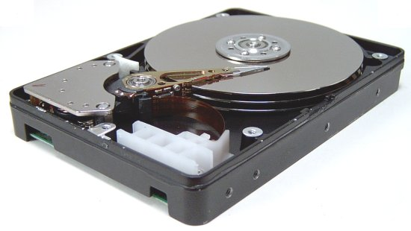
Hard Disk Drive
Actuator Arm
Platters
Actuator
Head

Slide 2
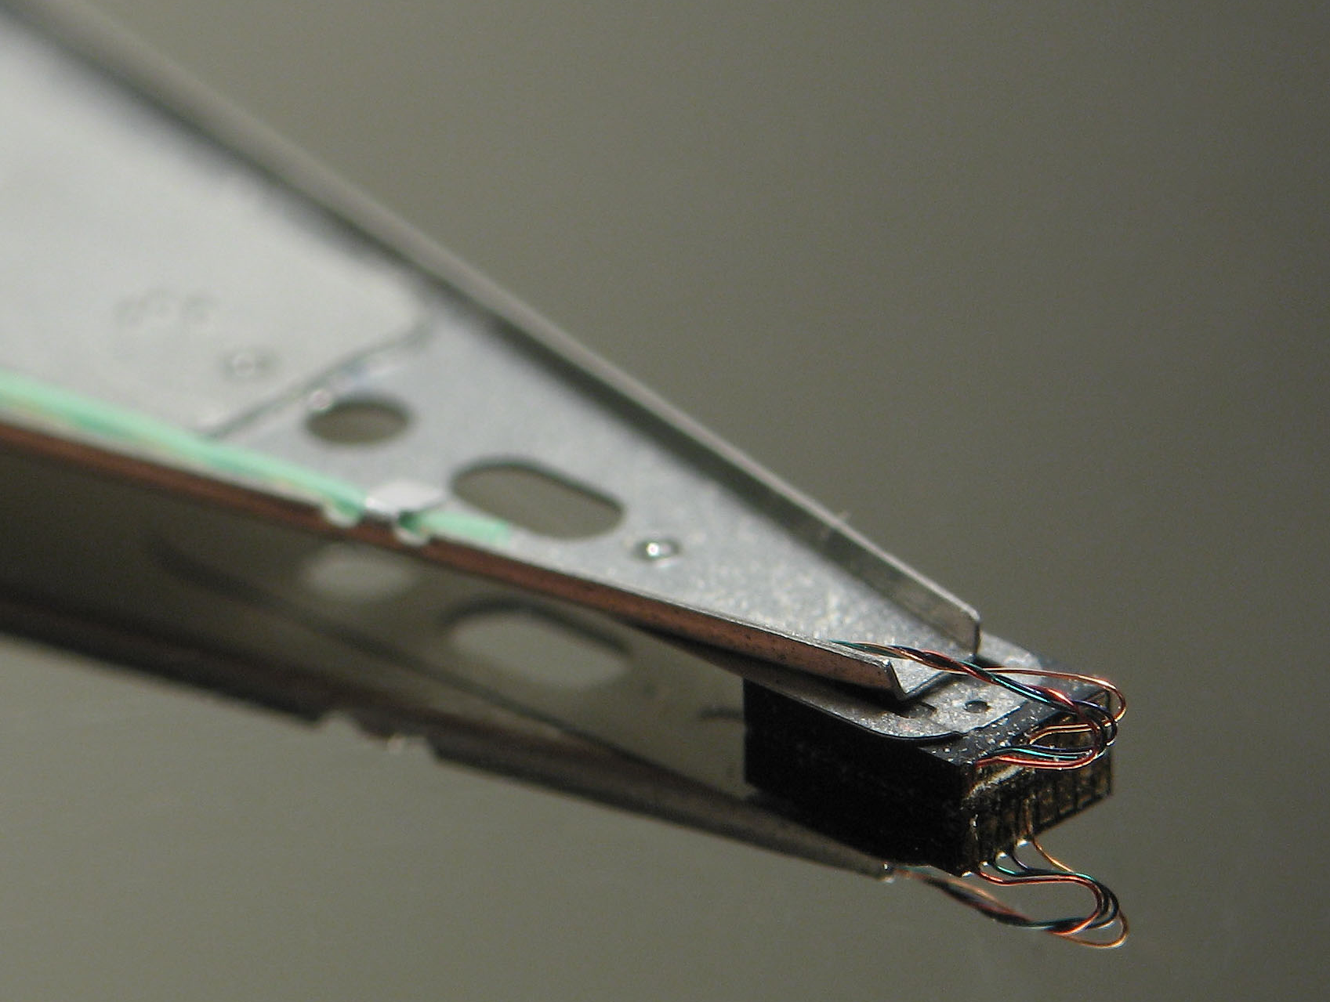

Slide 3
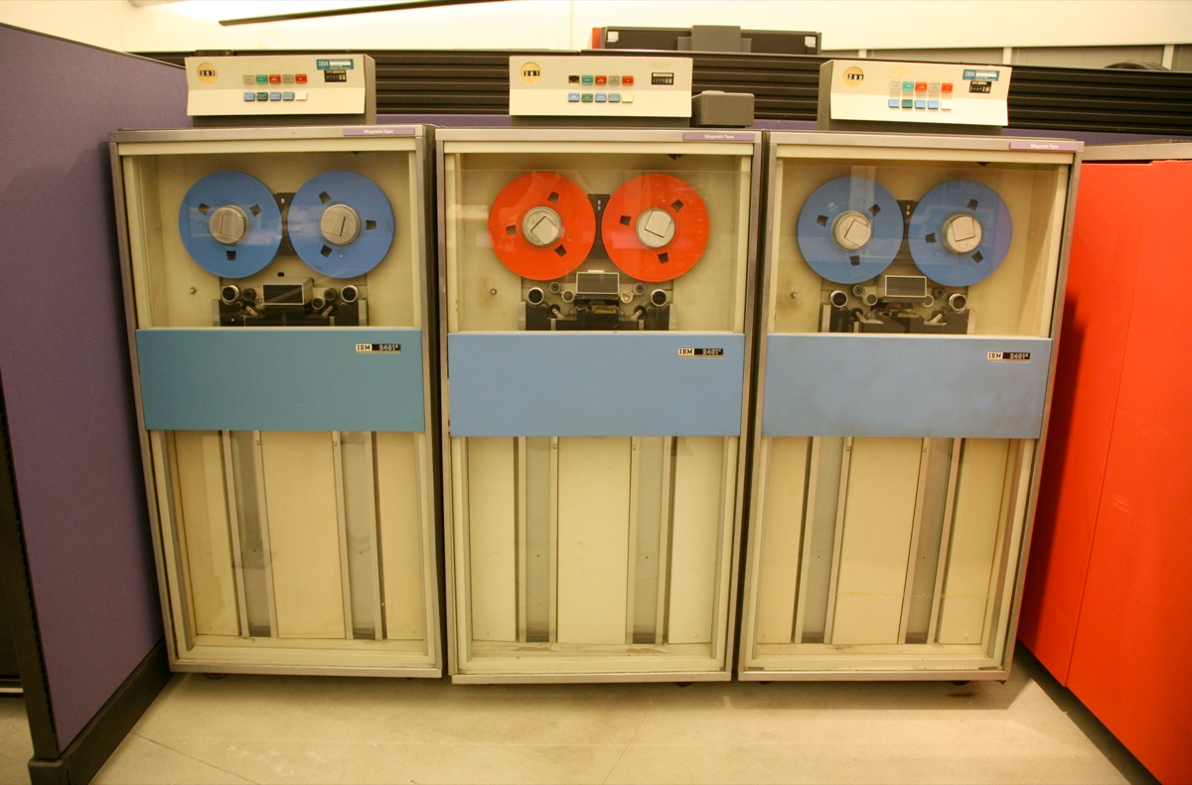
Old-Style Magnetic Tape

Slide 4
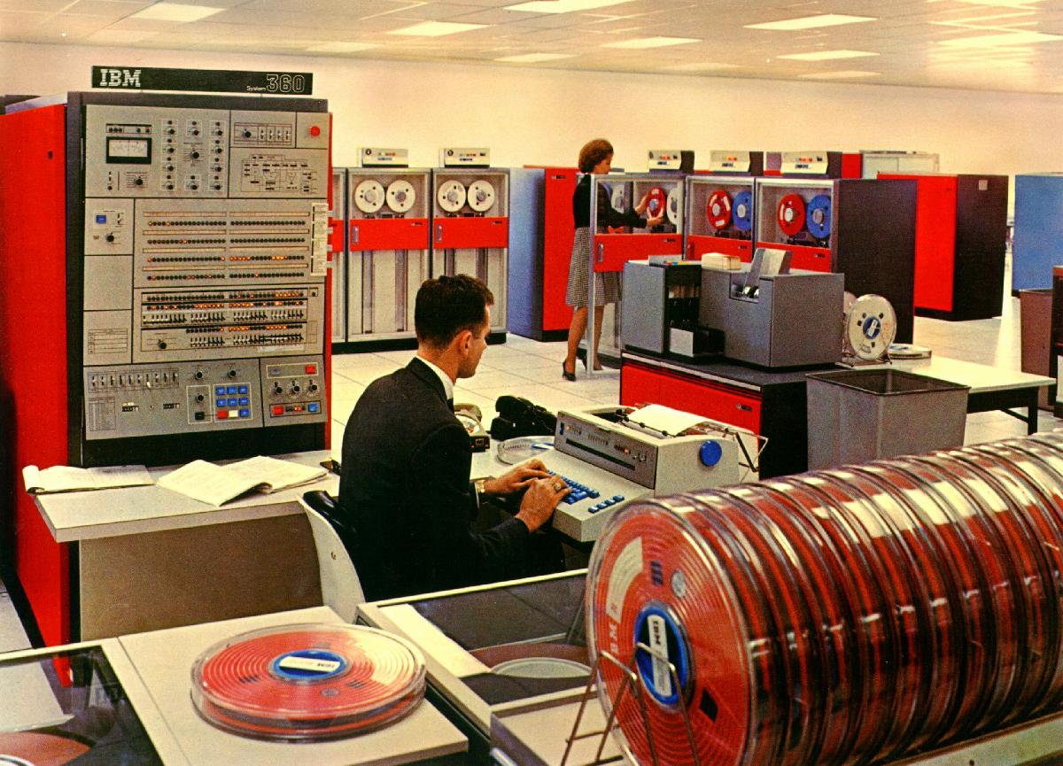
System 360 Datacenter

